Slide 1
Awesome Summer Fun
Nikolai Miranda

Slide 2
Awesome Summer Fun
West Virginia
Russia
Camp
Baseball Games
Pools

Slide 3
West Virginia

Slide 4
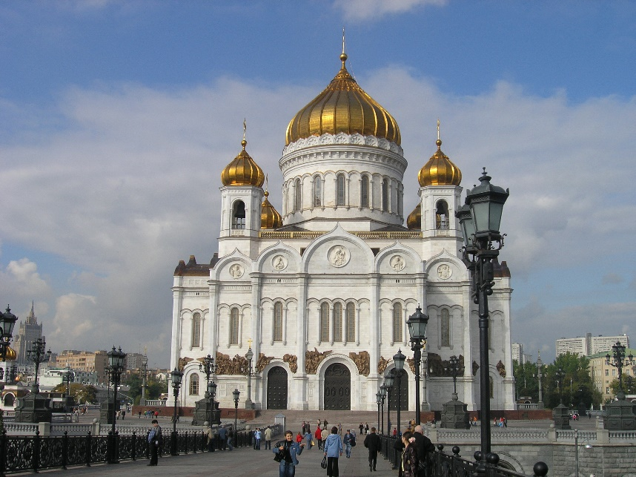
Russia

Slide 5
Camp

Slide 6
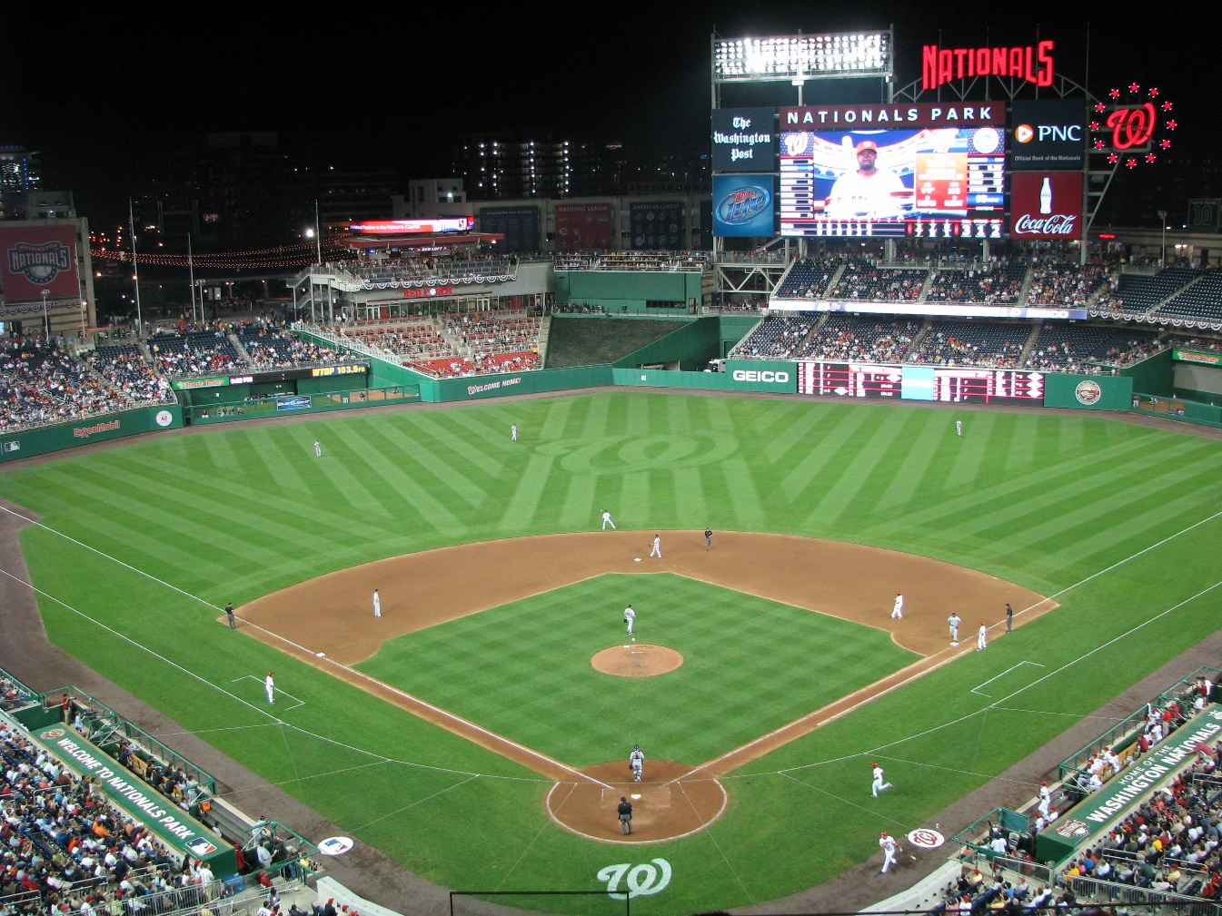
Baseball Games

