Slide 1
Michael powers

Slide 2
Beach
Baseball
Pool
Football
cartoons

Slide 3
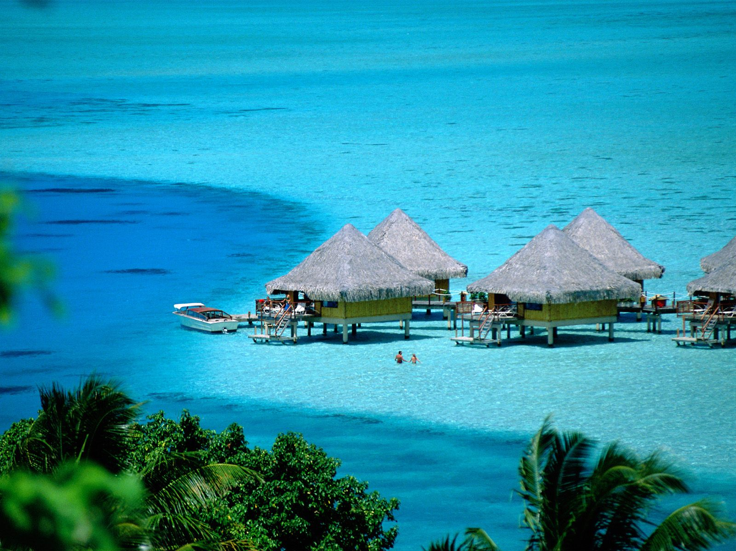
Beach

Slide 4
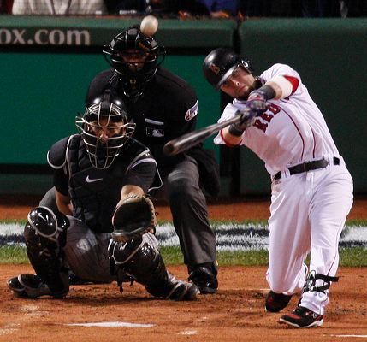
Baseball camp

Slide 5
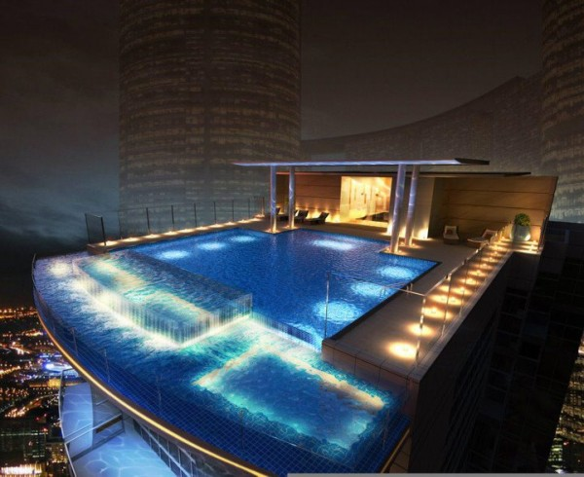
Pool

Slide 6
Football

Slide 7
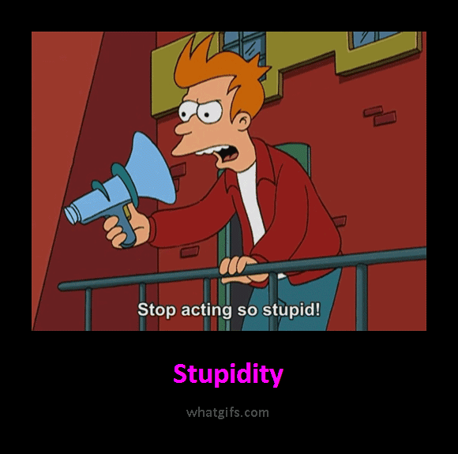
Cartoons

