Slide 1
Summer Fun!
Hailey Angier

Slide 2
Bethany Beach
Swim Team
Tennis
Candy Kitchen

Slide 3
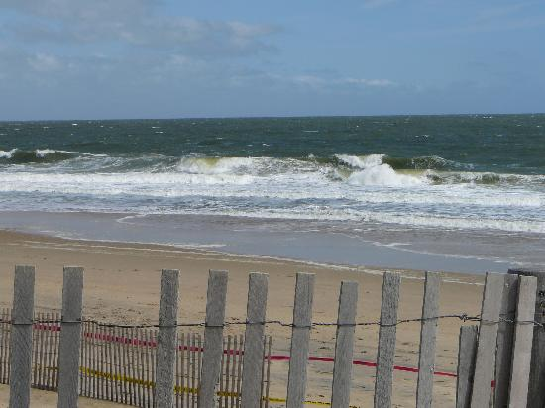
Bethany Beach

Slide 4
Swim Team

Slide 5
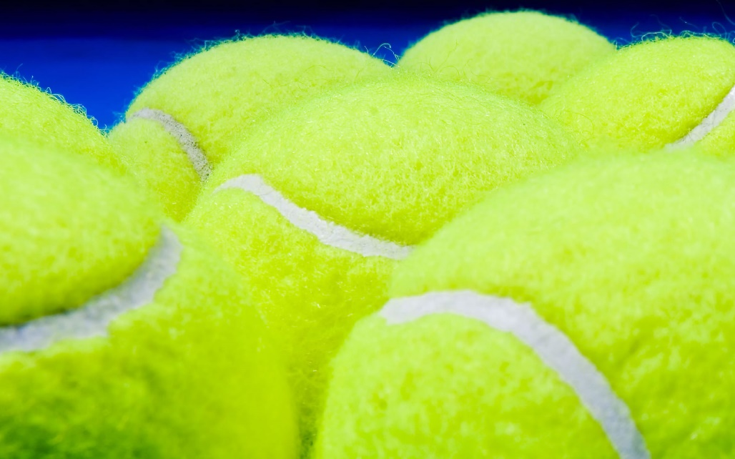
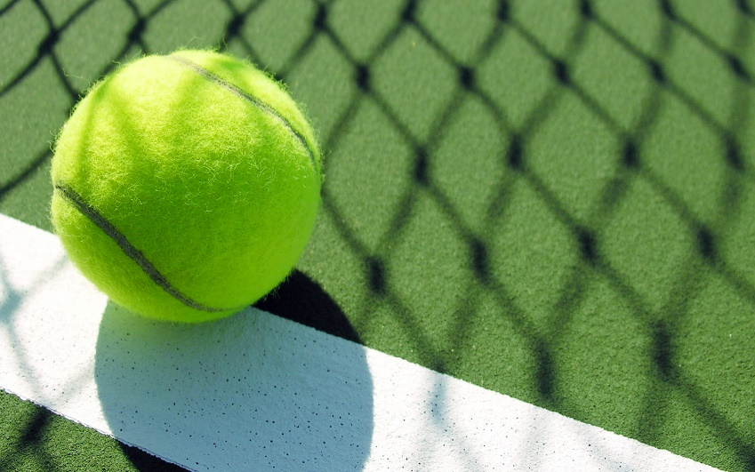
Tennis

Slide 6
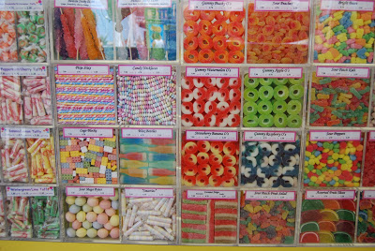
Candy Kitchen

