Slide 1
SUMMER FUN!☺
LUKE GALVIN

Slide 2
Play baseball
Play basketball
Go to Ocean City
Sleep
Camp
Eat

Slide 3
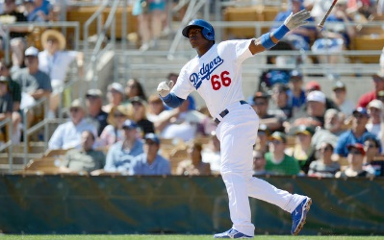
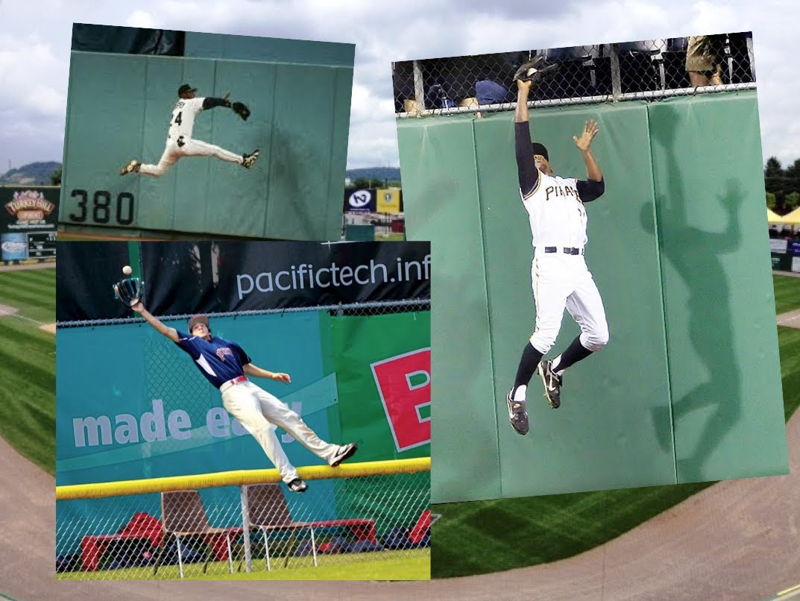
Play Baseball

